Slide 1
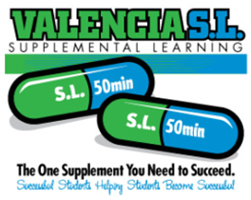
Supplemental Learning 2014

Slide 2
Overview
Same Ol’ SL
What’s New?
Exciting Data
How to get involved

Slide 3
Supplemental Learning (SL)
SL assisted courses provide students with a trained peer mentor. The SL Leader acts as a model student in class and leads group study sessions outside of class.

Slide 4
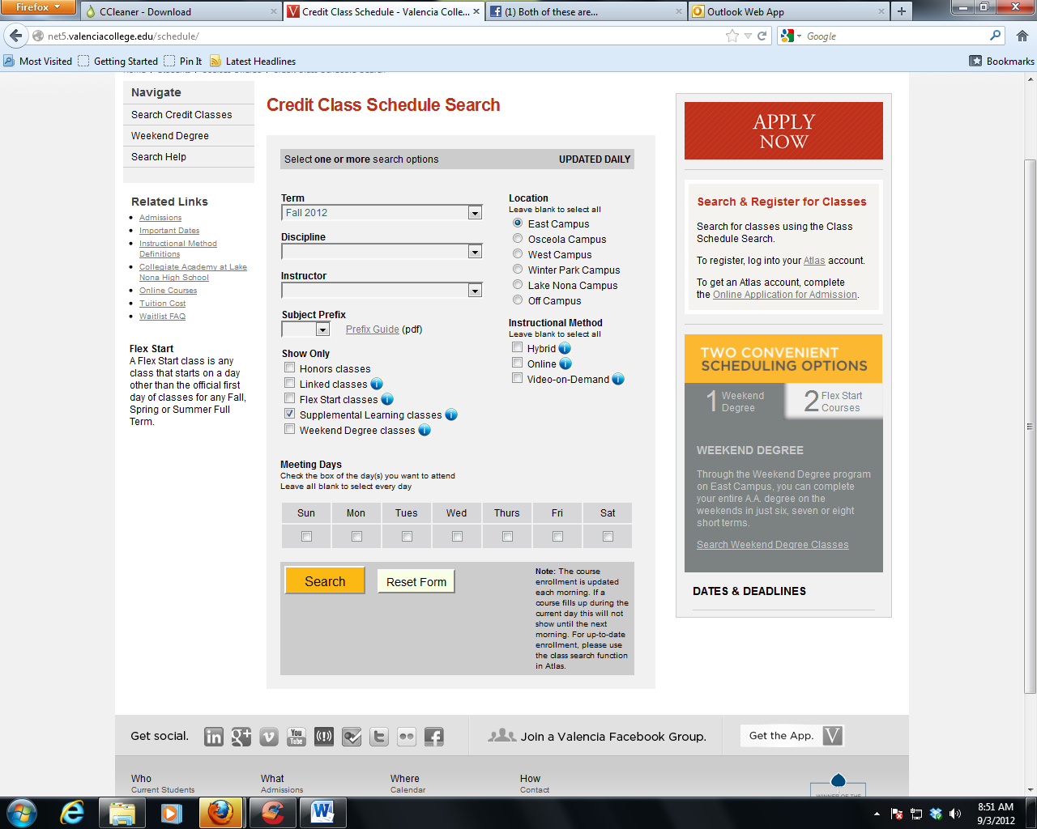
SL Class Search
Students are able to search for classes assisted by Supplemental Learning before registering for classes.
Go to www.valenciacollege.edu
Select Class Schedule from the Quick Links dropdown box.
Choose the term and Campus.
Check the box that says Supplemental Learning classes.
Click Search.

Slide 5
SL Program Organization
Stacy Johnson
East & Winter Park Campus President
Leonard Bass
East & Winter Park Dean of Learning Support
Jennifer Adams, Rob Schachel, Daeri Tenery
East Campus SL Coordinators (Math, Communications, Science)
The campus deans and coordinators meet regularly to share best practices, discuss program improvements, and to maintain common standards.

Slide 6
SL’s Focus on Math
MAT0028c/1033c Intensive
MAT1033c/MAC1105 Intensive
MAT 1033c
MAT 0022c
MGF 1106
STA1001c
MAT0028c
MAT0018c

Slide 7
AccuTrack
Students sign-in to SL sessions electronically using their VID
Attendance recorded in real-time
Reports available for faculty and deans on demand

Slide 8
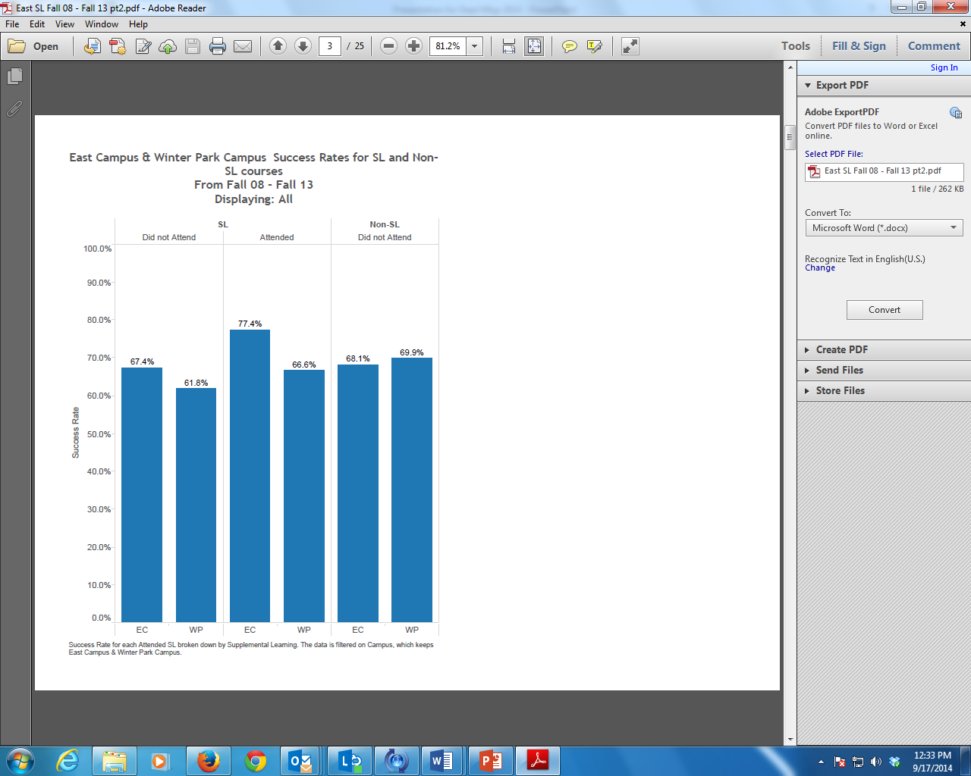
Exciting SL Data

Slide 9
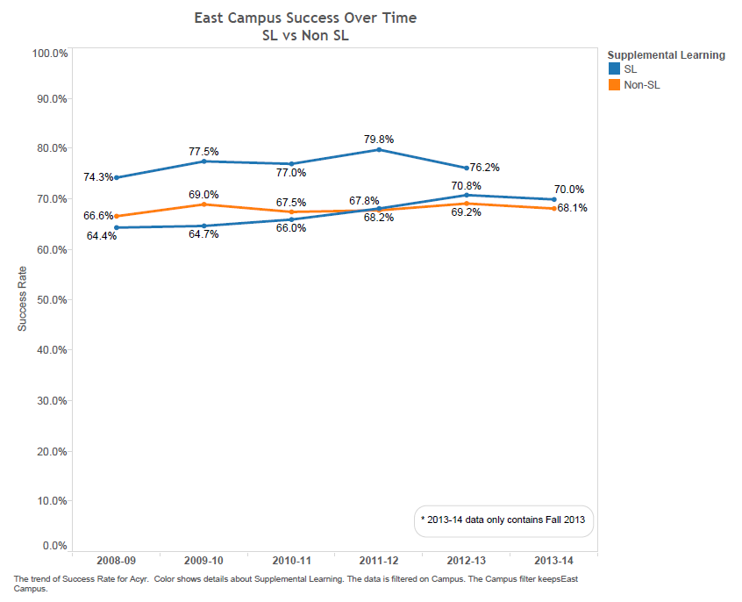
SL has been making a difference for years:

Slide 10
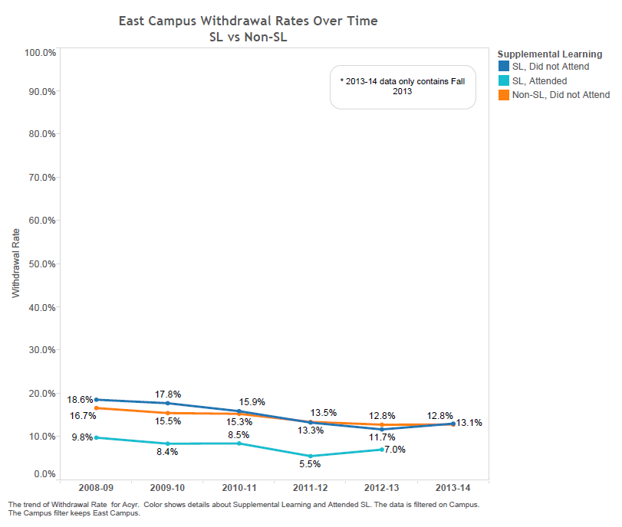
SL reduces withdrawal rates:

Slide 11
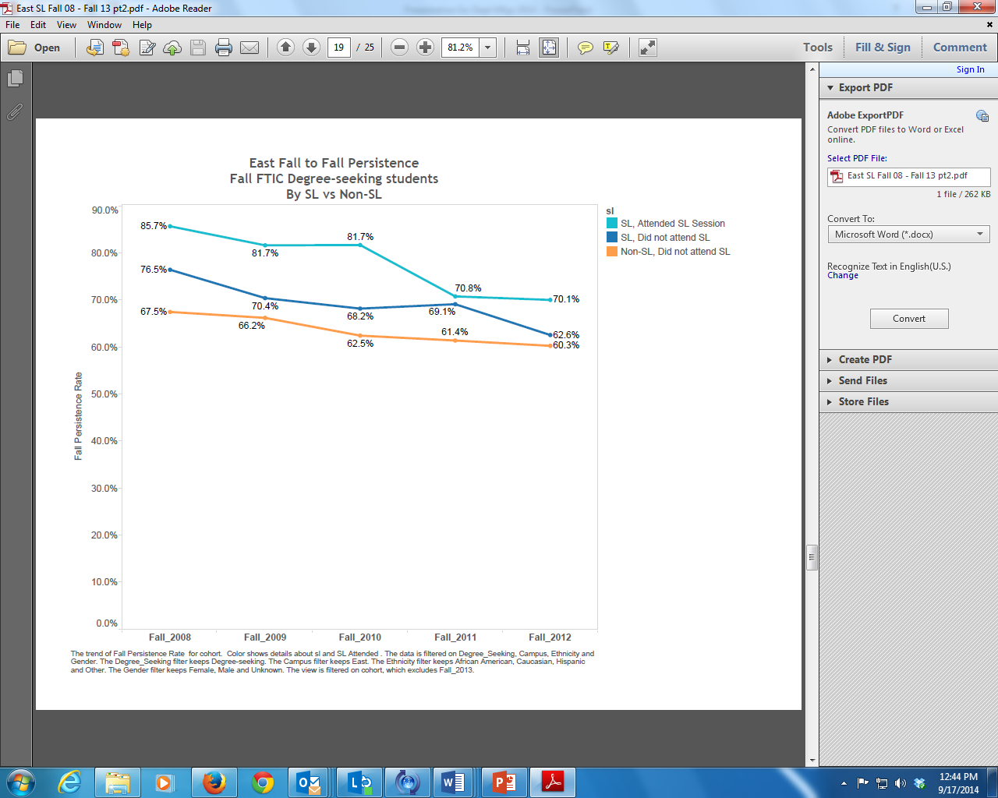
Students gain confidence in SL:

Slide 12

SL students persist:

Slide 13
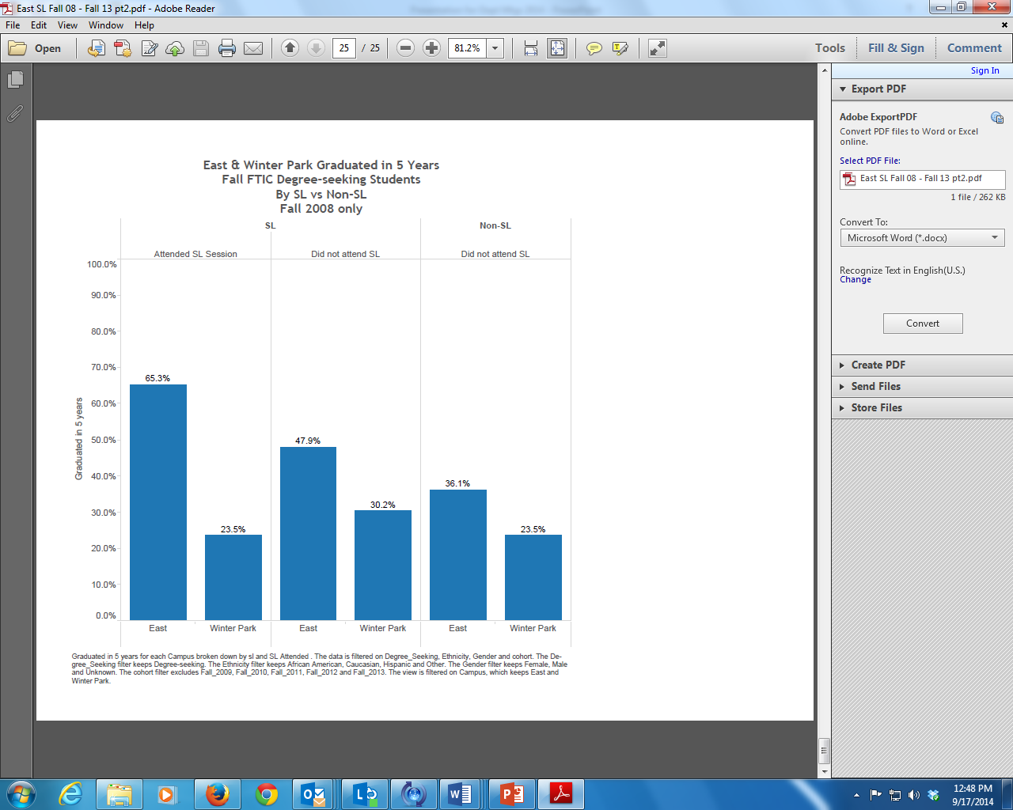
SL increases graduation rates:

Slide 14
How can you get involved?
Identify a model student that you would like to work with
Provide him/her with an SL application
Write a letter of recommendation
Take the SL Faculty Development course

Slide 15
SL Faculty Development Course
LCTS 3216
Elective credit in the LifeMap certificate
10 PD hours
Three weeks
Required for SL Faculty
Offered once every Fall and Spring
Next class starts Feb. 2, 2014 (CRN 2890)
Register in Atlas

Slide 16
Questions?

